Slide 1

Long-Jumping the Sports Earnings Gender Gap
Andrew Baker
Spring 2022 DA 515
Catholic University

Slide 2
Data Source and Topic
Forbes Top 10 Highest Earning Athletes (1990-2021)
Forbes Top 10 Highest Earning Female Athletes (2021)
Forbes Top 50 Highest Earning Athletes (2021)
Only one female in top 10 from 1990-2021: Monica Seles (1992)
What should the world’s top female athletes be earning in 2021?

Slide 3
Disclaimers
Earnings is defined as the sum of salary and endorsements.
Important features not included:
How successful each athlete is in their sport
Social media presence – more marketable to sponsors
Country of residence
Assumption that top 10 female athletes are working, performing, competing, and succeeding at the same level as the top 10 male athletes.

Slide 4
Features
Age
Nationality
Sport
Age in 2021
Age they became a professional
Number of years pro in 2021
Whether they are an Olympian
Whether they earned a college degree (Bachelor’s or greater)

Slide 5
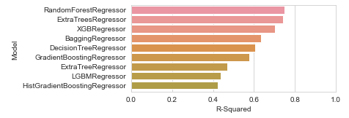
Training & Testing
Started with the top 10 athletes from each year 1990-2021.
Performed Train-Test split as normal using sklearn.
Used LazyPredict to look at which models are most compatible.
Build an ensemble with the top 5 models
Top 5 (all regressions): Random Forest, Extra Trees, XGBoost, Bagging, and Decision Tree.

Slide 6
Training & Testing
Built each model individually
Used test group to score and verify the mean squared error is not too great
Tuned the hyperparameters to improve/optimize both
Refit the models to the entire 1990-2021 data (no train-test split)
Saved each of the five models
Note: I was curious, so I saved the models that were only fit to the training data as well to see if they differed much if at all.

Slide 7
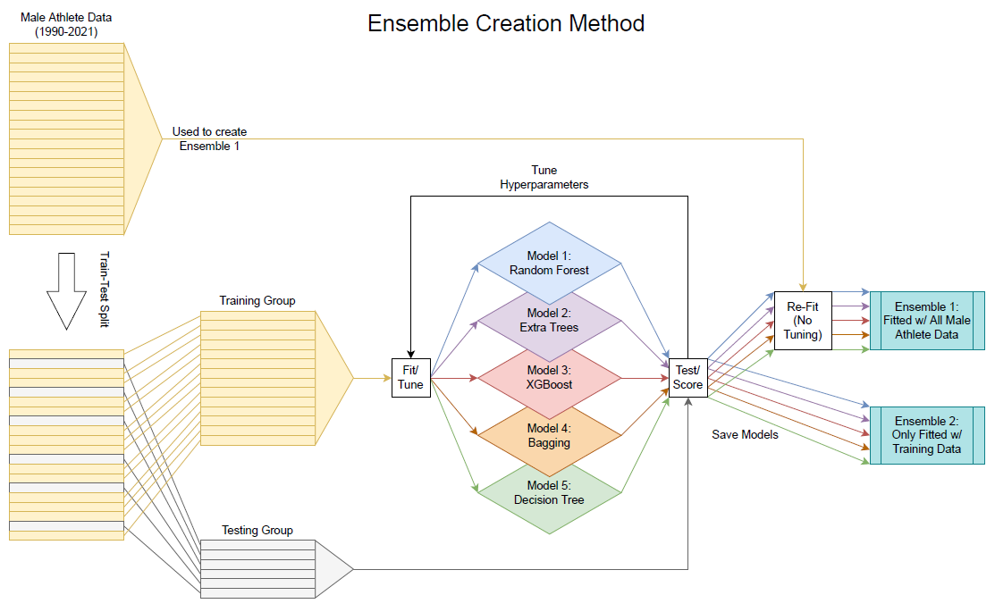

Slide 8
Analysis Process
Combined the models into an ensemble
Tested the female athlete data to generate the predicted earnings for each model.
Averaged the results from all models for each athlete to get their ensemble-predicted earnings.
Compared the predictions to the true earnings for each athlete.
Repeated these steps for both ensembles.

Slide 9
Findings (ensemble vs. ensemble)
Models fitted with all male athlete data averaged a predicted earnings for the top 10 female athletes of $93.6 million.
Models only fitted with the training data predicted an average of $95.7 million.
The variance between these two predicted averages is a mere 2.2%.
Very happy to see that it did not vary too much.

Slide 10
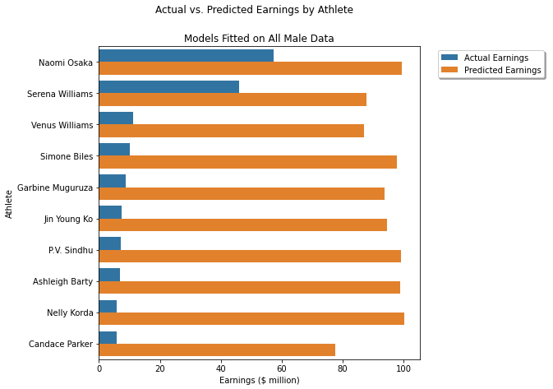
Findings
The only two female athletes to make more than half of their predicted earnings in 2021 are Naomi Osaka and Serena Williams. Both are in the top 50 overall for 2021.
All other female athletes earned less than 15% of their predicted earnings in 2021.

Slide 11
Findings
Each of the top 10 female athletes in 2021 are all Olympians compared to men’s 6 Olympians.
6 of the top 10 females are college graduates vs. 3 of the top 10 males
The average earnings of the top 10 male athletes in 2021 was $105.2 million
The average predicted earnings of the top 10 female athletes in 2021 was $93.6 million
The actual average of the top 10 female athletes in 2021 was $16.7 million

Slide 12
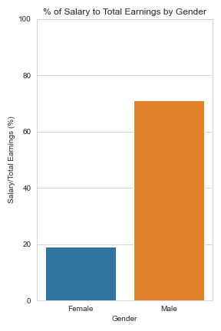
Findings
Primary income from sponsorships more likely for women.
For the top 48 male athletes, they make an average of 71% of their earnings in salary, the rest is endorsements.
For the top 10 females, they make an average of 19% of their earnings in salary.
Speculation: I believe this is the reason the top 10 females are all Olympians; they’re highly marketable when the American people are actively following them during the Olympics.
This list came out in 2021 around when the 2020 Summer Games were wrapping up. Although not all competed in the 2020 games, all top 10 females play summer sports (tennis, badminton, golf, basketball).

Slide 13
Closing the Gap
Profitability of an athlete depends on many factors, including viewership.
Until women’s sporting events are televised/attended more -- thus making the sport -> team -> player more profitable -- the primary reason for the gap will remain.

Slide 14
Difficulties
Did not start with LazyPredict
All models except Decision Tree were horribly inaccurate (LazyPredict later corroborated)
Had to retrieve Year Went Pro, Birth Year, Olympic, and College data for each athlete as it was not included in Forbes’ dataset.

Slide 15
Questions? Comments? Ideas?

